Slide 1
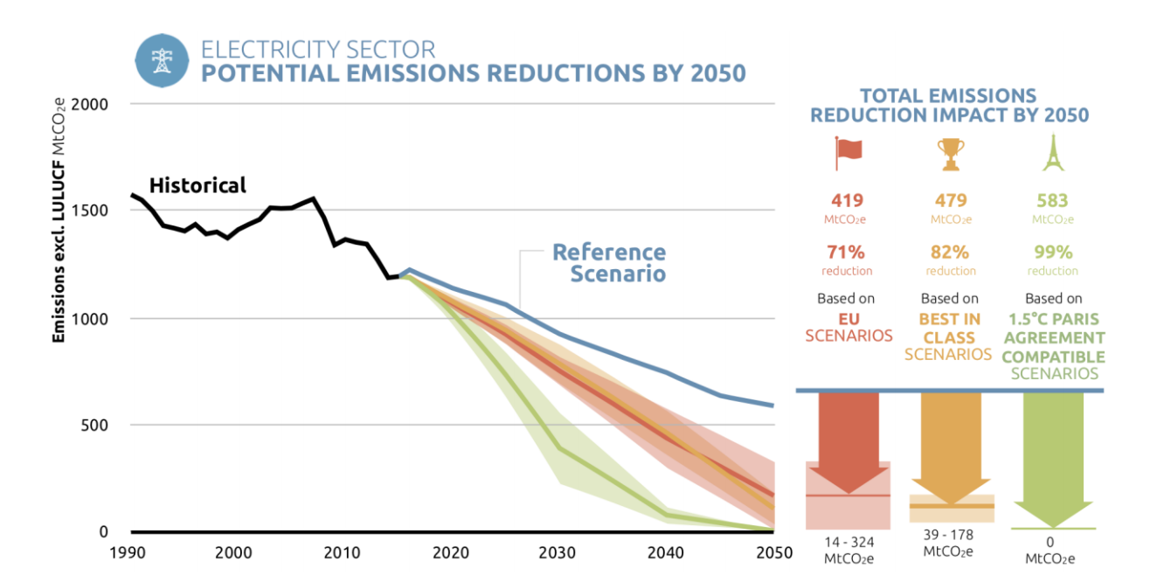
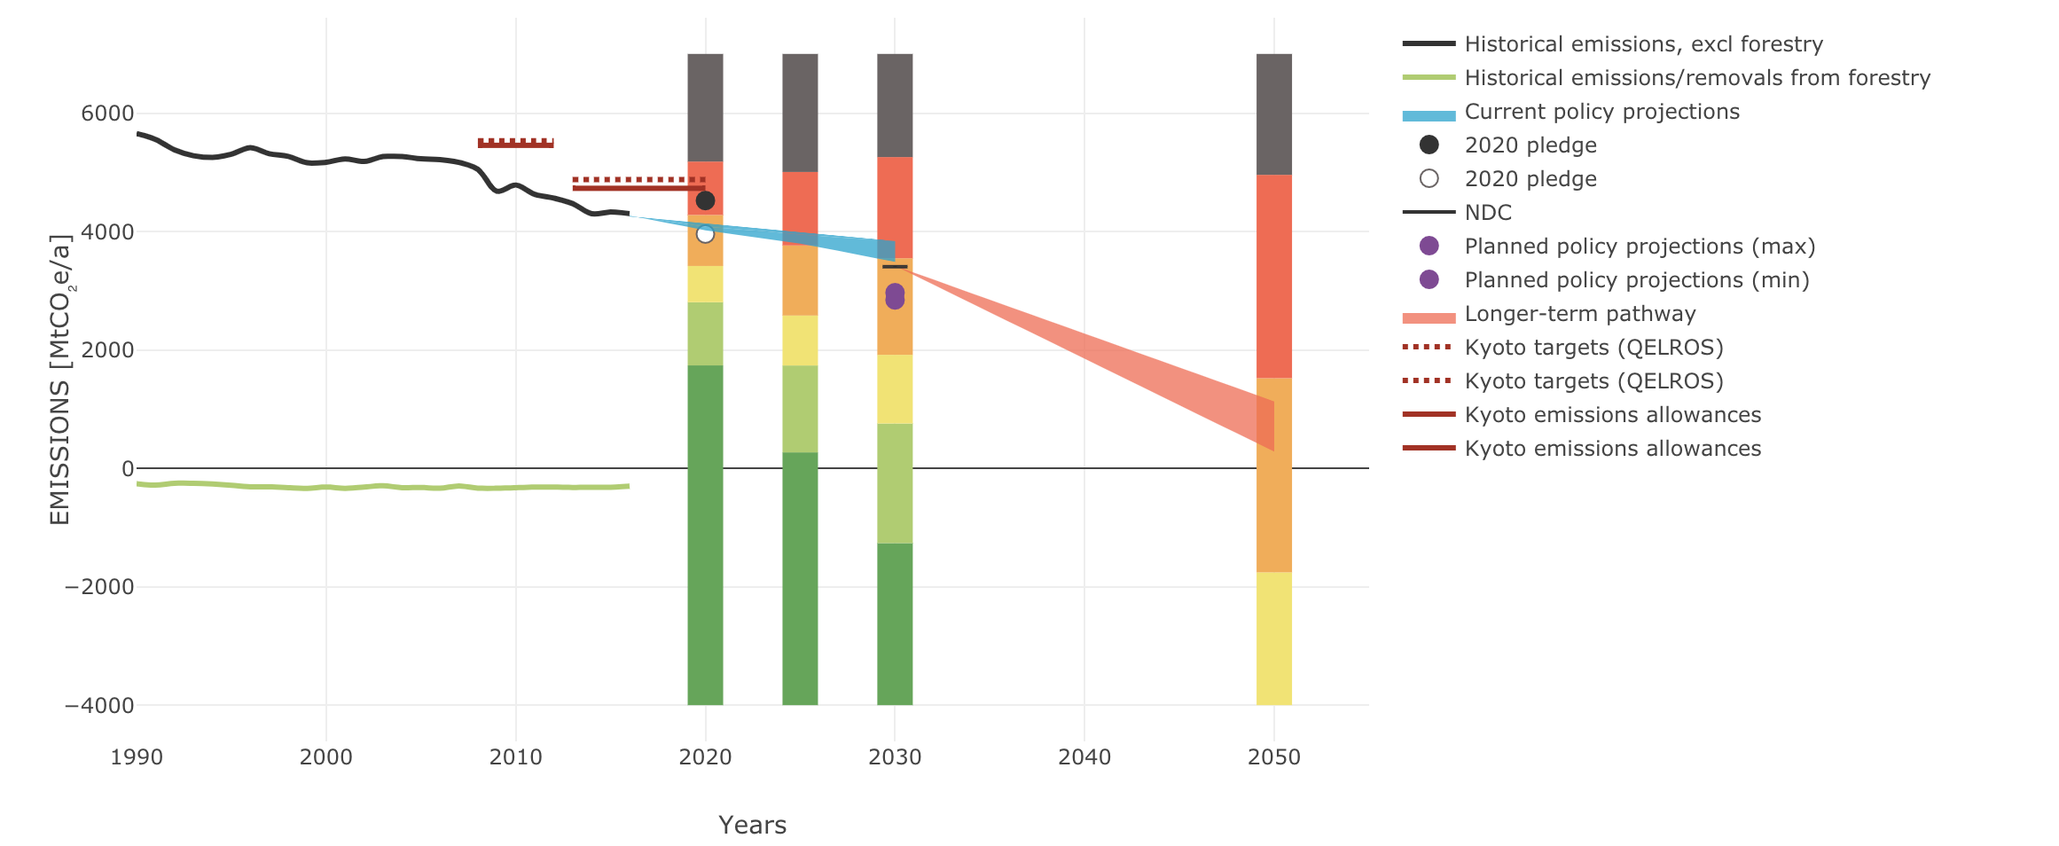
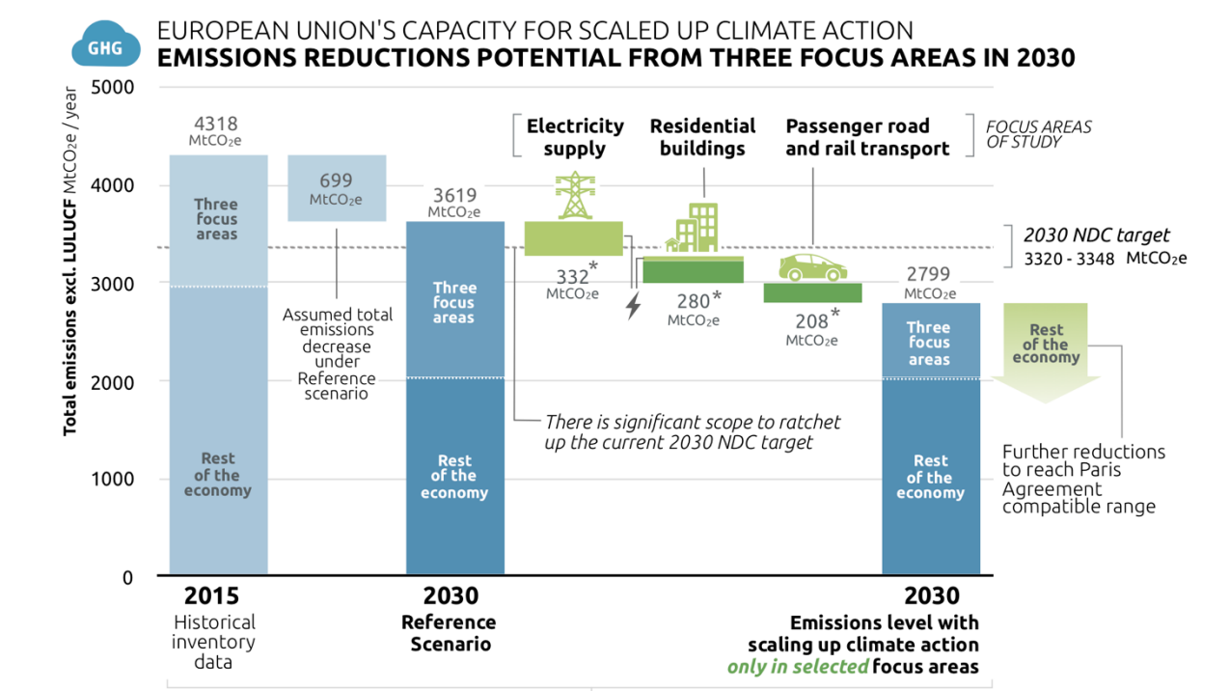
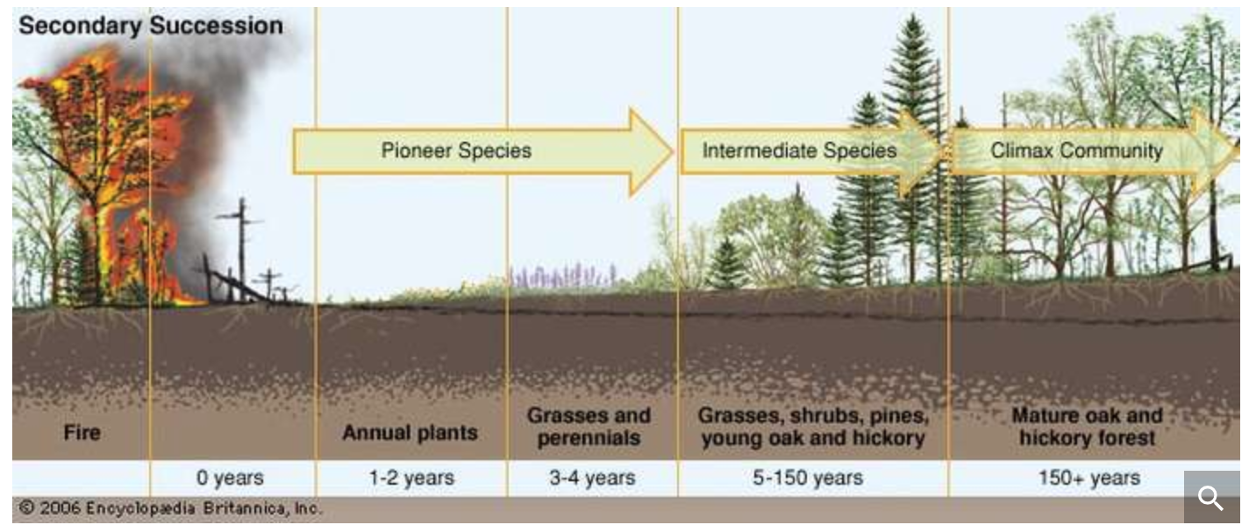
30% reduction of emissions from both cars and vans
Average emissions of the EU fleet of new cars in 2030 will have to be 30% lower than in 2021. For the EU fleet of new vans in 2030, the reduction also amounts to 30%.
For 2025, targets for cars and vans are 15% lower than in 2021, so as to ensure that emission reductions occur as early as possible.
future
While replacing fossil fuels with renewables is essential for decarbonising the transport and buildings sectors, sectoral integration would also make it easier to increase a significantly larger share of variable renewables in the electricity sector. https://climateactiontracker.org/documents/505/CAT_2018-12-06_ScalingUp_EU_FullReport.pdf
Developments during 2018 in the European Union’s climate and energy policy are steps in the right direction towards re-establishing the EU’s position as a global leader on climate action.
https://climateactiontracker.org/countries/eu/https://climateactiontracker.org/countries/eu/
Hydrogen
Hydrogen cars - also known as fuel cell cars - are in their first stages of development. With far less parts in an engine than usual, compressed hydrogen is pumped into the car which is transformed into electricity and creates the motion of the wheels. The only emission of this is pure water, clean enough to drink. You can find only a few hydrogen pumps around the UK, but these developments could mean a possible new generation of cars with lower emissions and lower running costs.
DEVELOPMENT
After a commitment last month to cut greenhouse gas emissions from shipping by at least 50% by 2050, the race is on to find new technologies that can green the 50,000-strong global shipping fleet. Wind power is one of the options being discussed.
https://www.theguardian.com/environment/2018/may/03/future-sailors-what-will-ships-look-like-in-30-years
https://frontier.ac.uk/blog/2018/09/05/eco-friendly-cars-of-the-future---electric-hybrid-or-hydrogen
https://climateactiontracker.org/documents/505/CAT_2018-12-06_ScalingUp_EU_FullReport.pdf
EMISSIONS TRACKER
http://needtoknow.nas.edu/energy/energy-costs/environmental/
outcome
OUTCOME OF SUCCESSION 1. Species of organisms usually replace one another in the sere since populations make conditions suitable for others. 2. There is acceleration of the replacement process since some species that make conditions favorable for others , in turn create unfavorable conditions for themselves. 3. There are changes in the structure of species and the community activities due to changes in physical environment with time. 4. It brings about an equilibrium since bare or abandoned habitats are colonized by a variety of organisms similar to those in the neighboring habitats. 5. The establishment of the climax community is the final outcome of succession.
https://www.slideshare.net/Jetfire/cradletocradle-design-creating-healthy-emissions-a-strategy-for-ecoeffective-product-and-system-design
We report on carbon emissions per 100,000 orders, and we focus on reducing our carbon intensity through operational efficiency. Our business has grown significantly since our baseline year of 2012/13, so naturally, our absolute carbon emissions have risen. Since 2015, our average order volumes have increased by 16.5%. Despite total emissions increasing, we've continued a five-year trend of improving our energy efficiency, resulting in a 27% improvement since our baseline year. http://www.ocadogroup.com/our-responsibilities/environment.aspx
PROCESS
The implementation of the Sulfacid process at the Jorf Lasfar and Safi industrial platforms required an overall investment of MAD 550 million and marks a an historical milestoneby reducing gas emissions by 98%. http://www.ocpgroup.ma/en/ocp-group-implements-sulfacid-process-eco-friendly-innovative-investment-reduce-gas-emissions-0
https://www.sabyfy.com/ecology-meaning-succession-characteristics-outcome-primary-secondary-and-process-of-succession/
https://www.britannica.com/science/ecological-succession

